Slide 1
Homecoming 2016
Liaison Meeting, September 6, 2016

Slide 2
Agenda
Introductions
Homecoming Court
Apparel
Philanthropy
Blood Drive
Individual Organization Fundraising
Events
Lip Sync
Questions, Comments, Concerns, Feedback, etc.

Slide 3
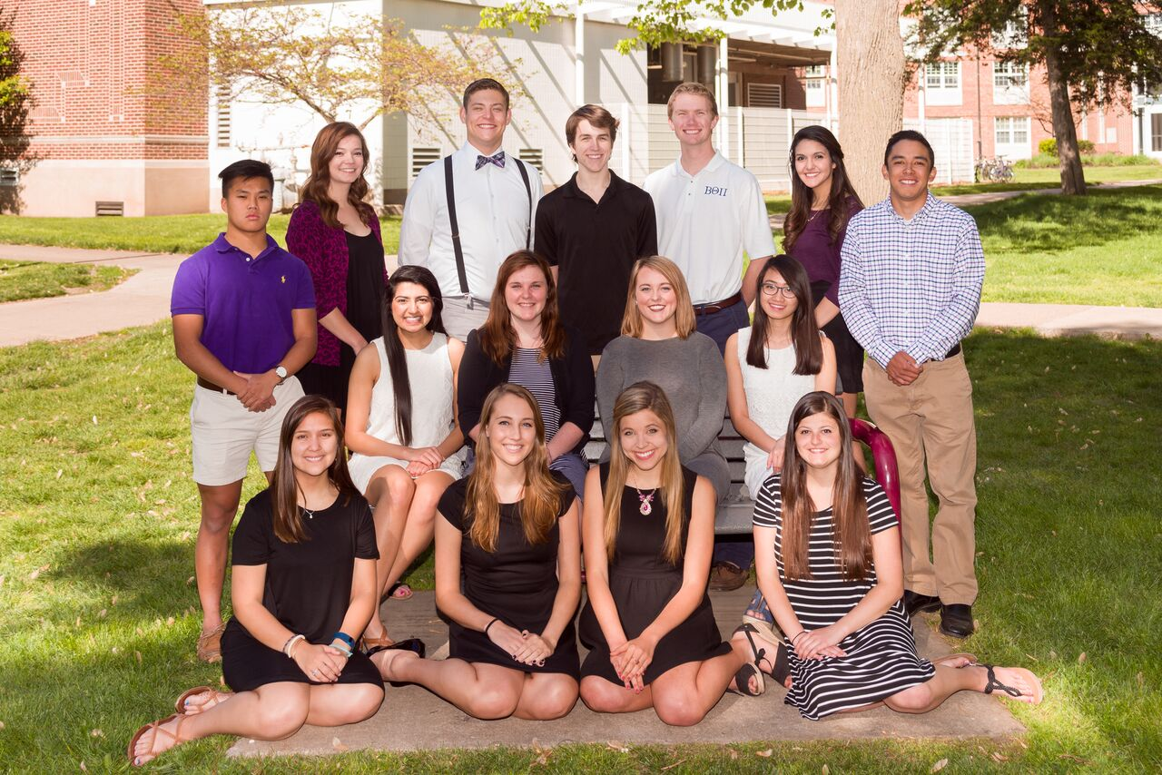
Introductions
Committee

Slide 4
Homecoming Court
Overall Court Dates & Deadlines:
Date | Task
9/19/16 | Nominations Due at 12PM AND Nominee Application Opens at 12PM
9/21/16 | Nominee Applications Due at 12PM
9/22/16 - 9/23/16 | Mandatory Quiz for Nominee
9/26/16 | Applicants will be notified about their interview times at 5PM
9/28/16 - 10/5/16 | Interviews
10/7/16 | Homecoming Court Announced
10/14/16 | Videos are due
10/16/16 | Online Voting Polls Open at 5PM
10/20/16 | Online Voting Polls Close at 5PM
10/20/16 | Videos played during Lip Sync Intermission, Court Event while the points are tallied, and Homecoming Court Winners announced
Process
Nominations, Applications, Quiz, Interview
Deadlines

Slide 5
Apparel
Designs
Pre-Order Due Dates

Slide 6
Philanthropy
Blood Drive
Individual Organization Fundraisers
Buddy Pack

Slide 7
Events
Yell-In

Slide 8
Lip Sync
What is going to be different?
Ophelia Parrish Performance Hall
Live Stream
Due Dates
First draft skit due September 21.
Clarify typos

Slide 9
Questions, Comments, Concerns, Feedback?

Slide 10
No Meeting Next Week due to Recruitment.
More information will be sent out via Email.

